Slide 1
COSP230 Ch. 8
Displaying Pictures in a GridView

Slide 2
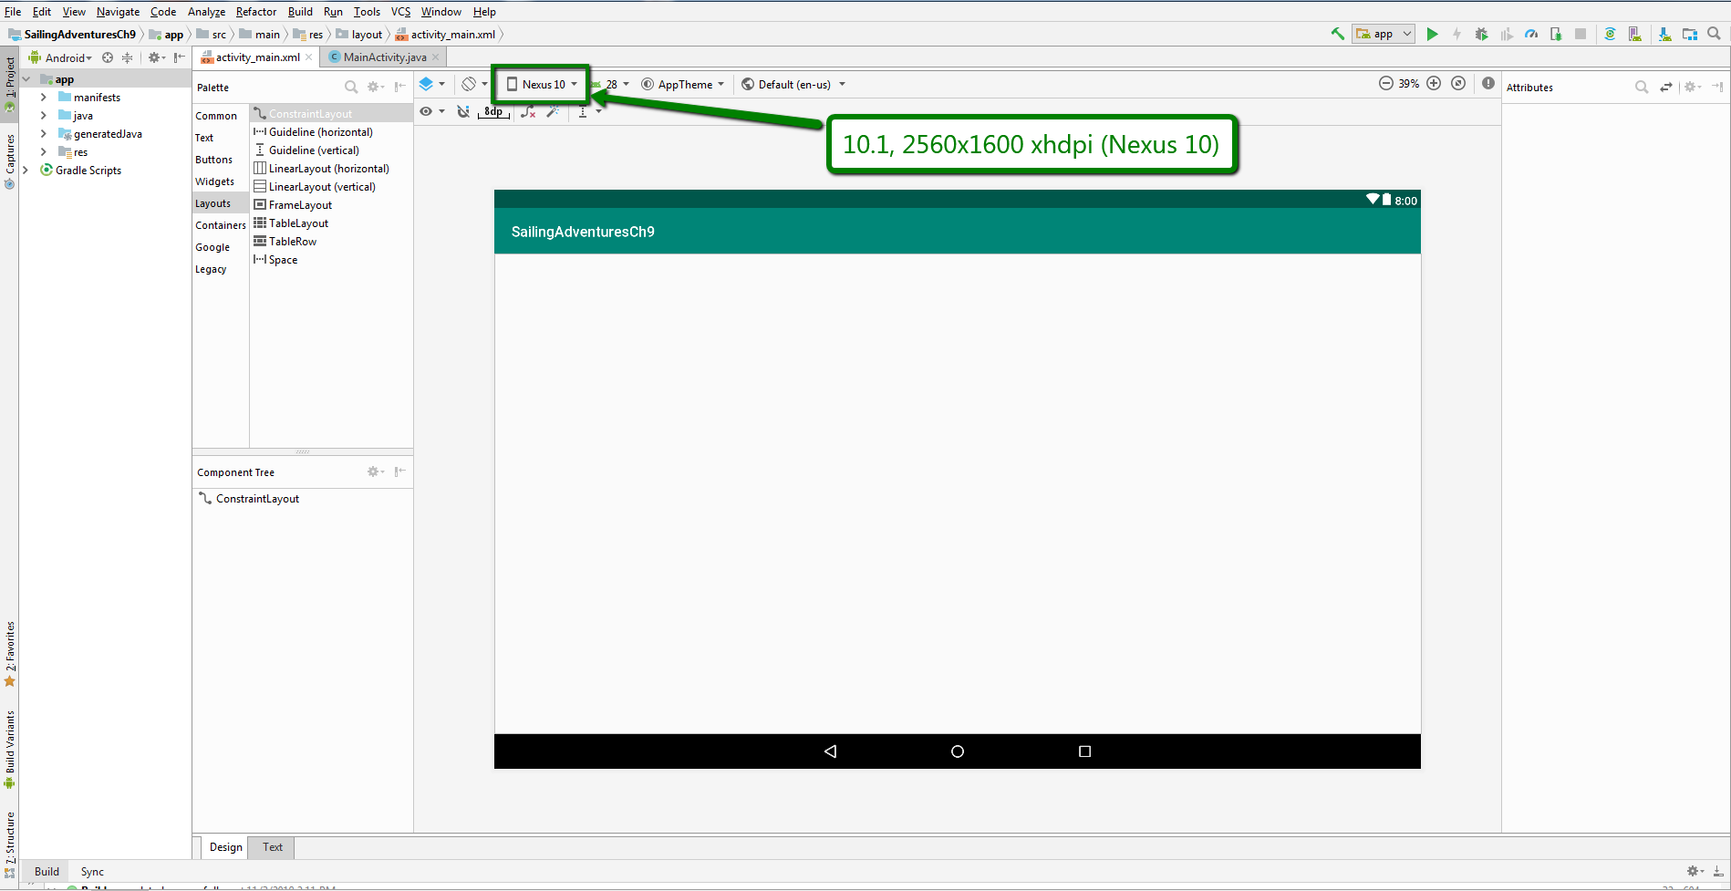
Start of Project (Delete HelloWorld text, select Nexus 10, keep as Constraint Layout for now):

Slide 3
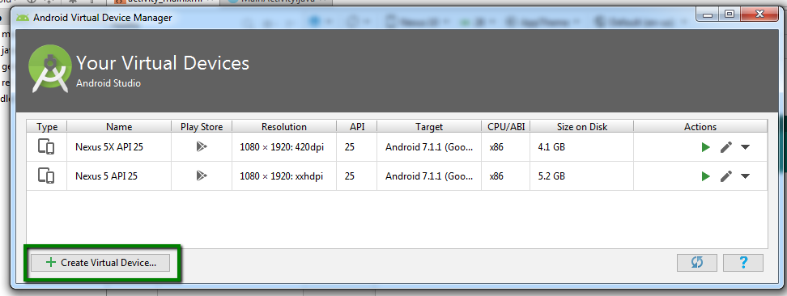
Create New Virtual Device (Nexus 10)
In menu bar, select the following:
Tools->AVD Manager
In the window that appears, click the Create Virtual Device… button

Slide 4
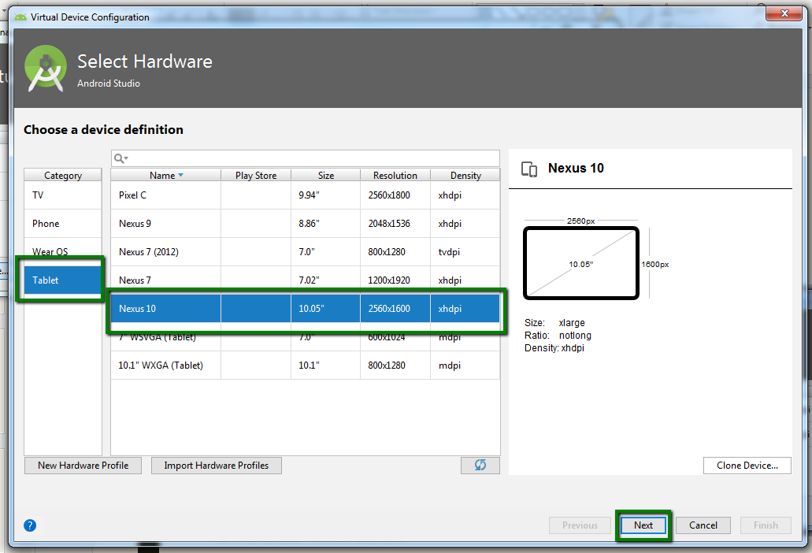
Select a Device Definition (Nexus 10)
Select Tablet in the Category area
Select Nexus 10 from the list of devices
Click Next

Slide 5
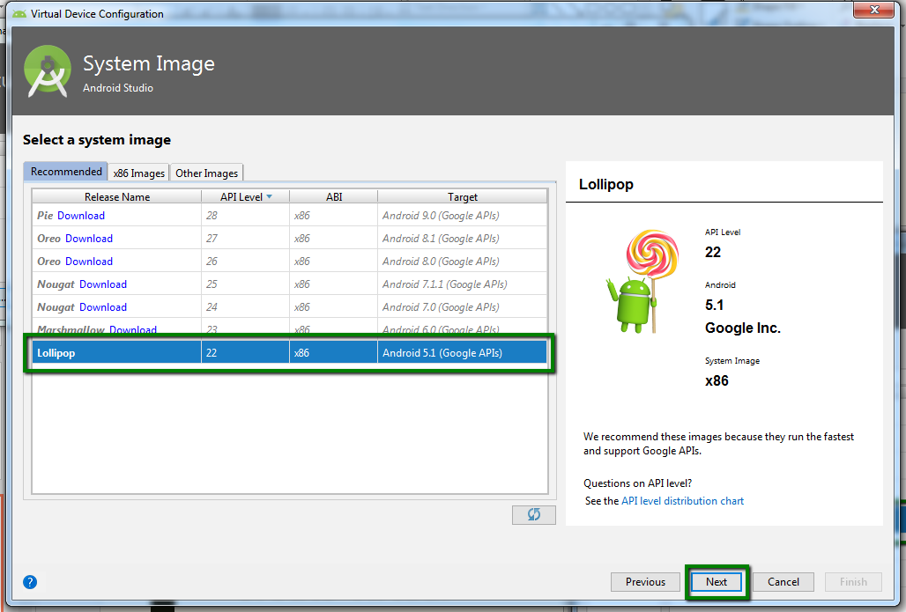
Select System Image (Lollipop)
Click the Recommended tab
Select Lollipop
You may have to download it first
Click Next

Slide 6
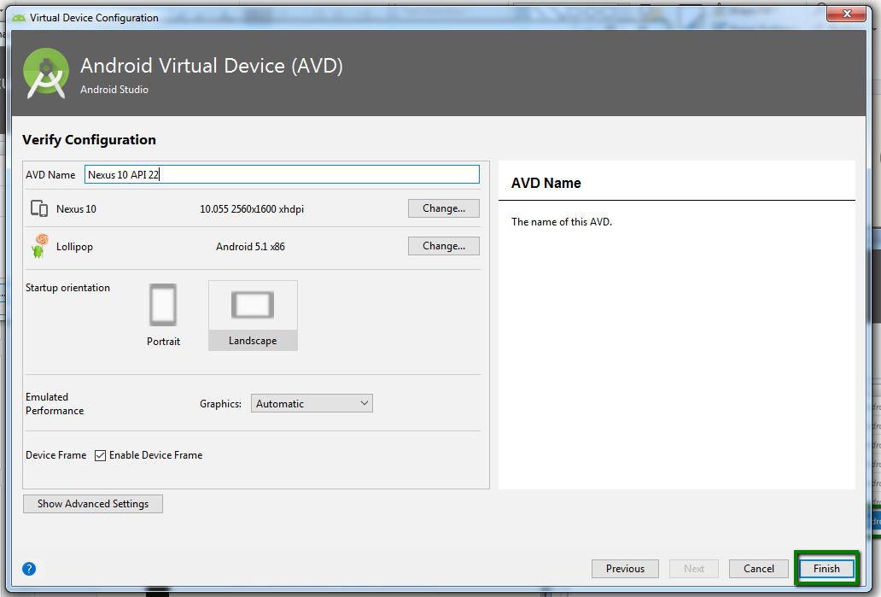
Click Finish to exit the AVD

Slide 7
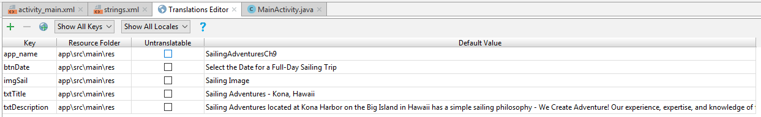
Add keys in Translations Editor
Open the Translations Editor
Add the keys in the table on the right
The textDescription key should have the text in the following text box:
Sailing Adventures located at Kona Harbor on the Big Island of Hawaii has a simple sailing philosophy – We Create Adventure! Our experience, expertise, and knowledge of the high seas provide our customers with the best chance of having an enjoyable and productive sailing adventure. Select a date for your sailing day trip.

Slide 8
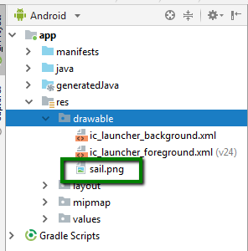
Add sail.png file to drawable folder
Download the sail.png file from Canvas
Copy and pasted this file into the drawable folder

Slide 9
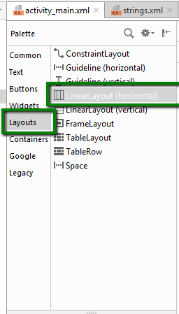
Change to Linear Layout (Horizontal)
Convert the Constraint Layout to a Relative Layout
In Palette, select Layouts
Then select Linear Layout (Horizontal)
Drag and drop this layout onto the emulator

Slide 10
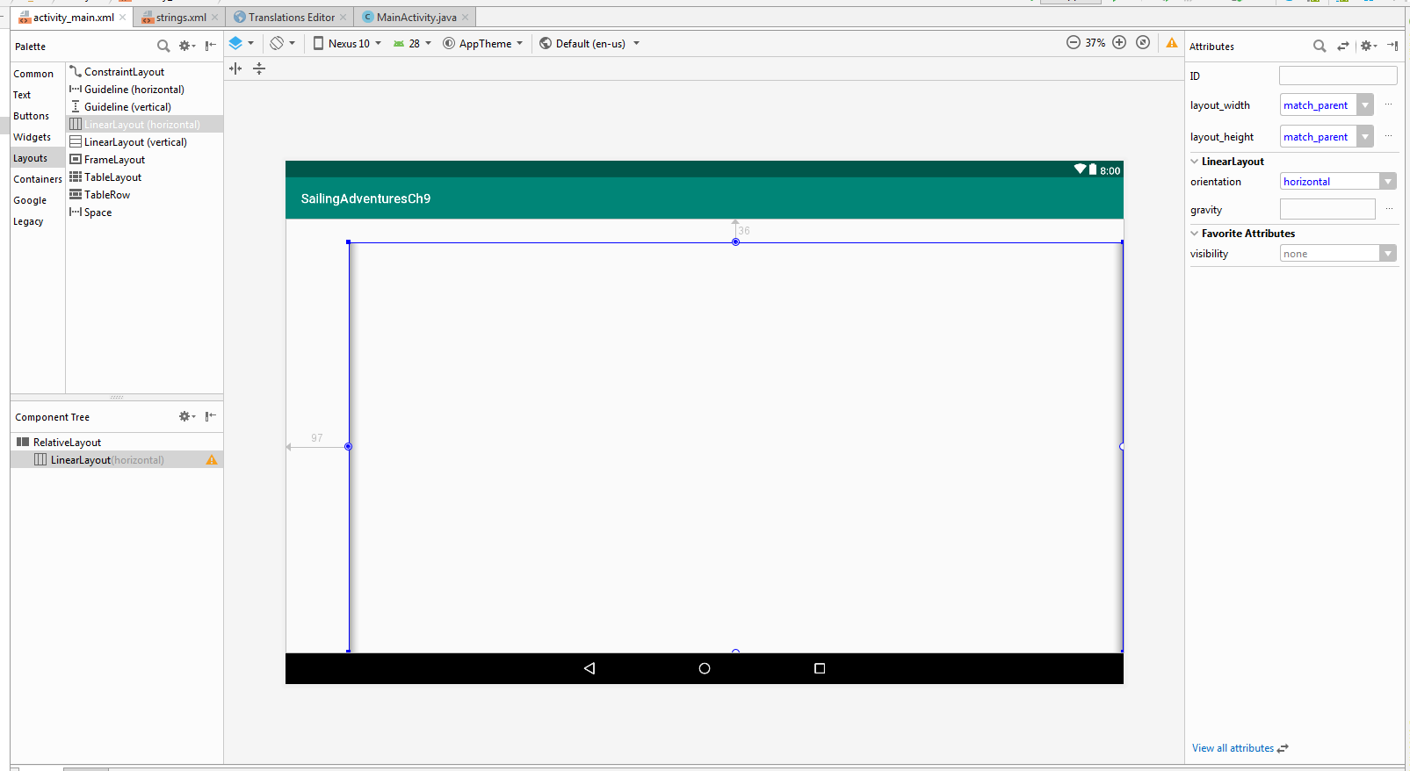
You should now have this:

Slide 11
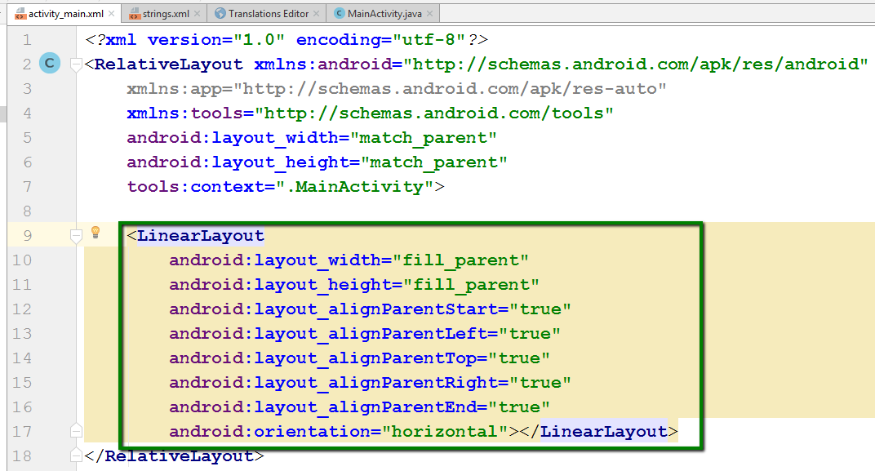
Update activity_main.xml for LinearLayout
In activity_main.xml, click on Text tab at bottom.
Change the XML code for the Linear Layout to what is shown here.
Delete all padding property settings.

Slide 12
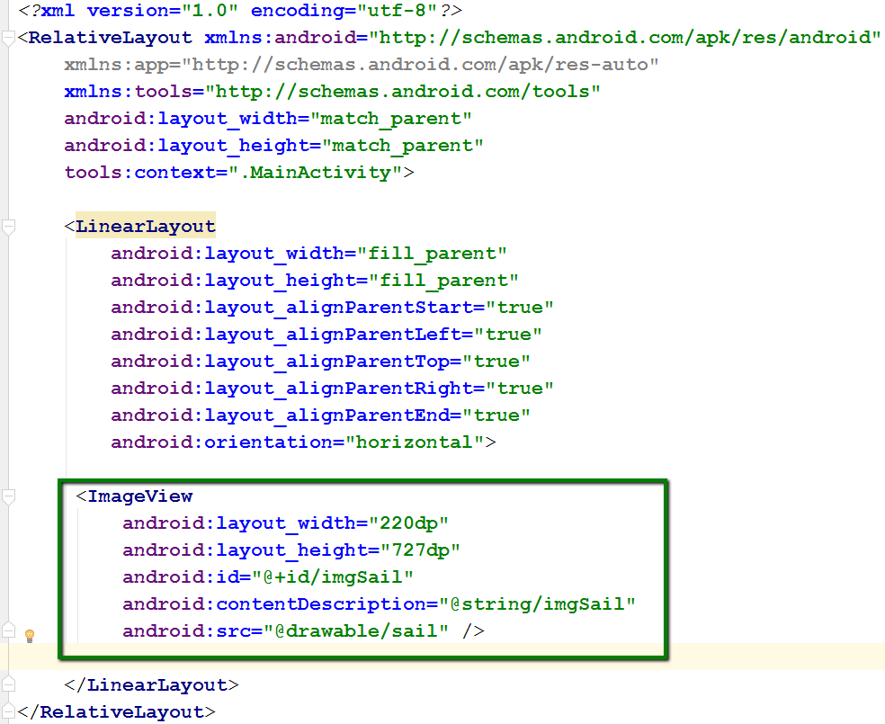
Update activity_main.xml to add ImageView
Add code in box as shown and in the location shown.

Slide 13
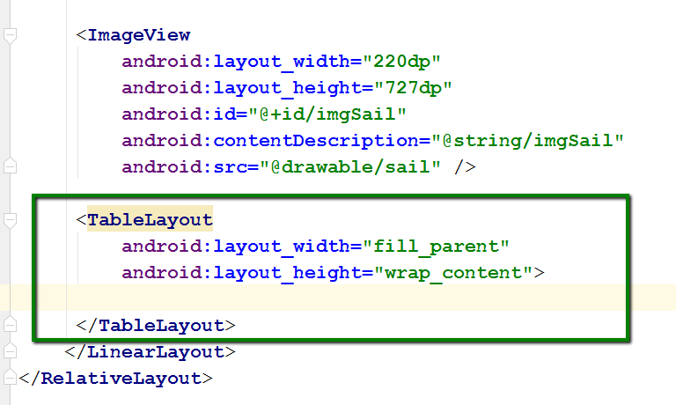
Add code for a TableLayout
Add the code in the box on the right at the location shown.
This table will have 4 rows. The next slide will have code for rows 1 and 2 and the slide after that will have code for rows 3 and 4.
Be sure all Table Rows are within the <TableLayout></TableLayout> tags

Slide 14
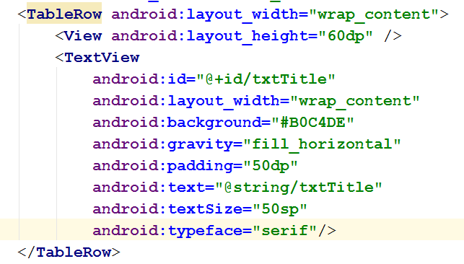
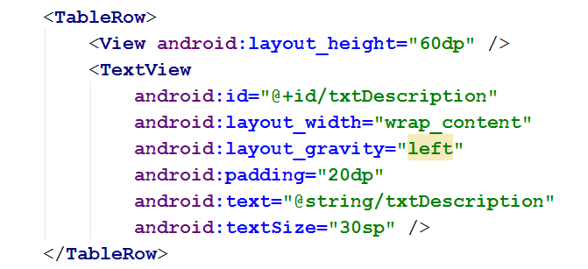
Code for Table Row 1 and Row 2
Row 1
Row 2

Slide 15
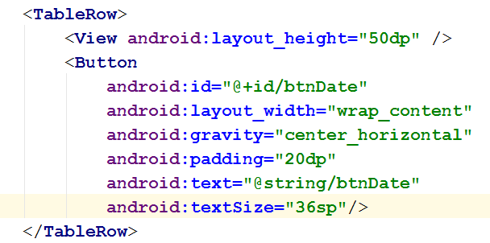
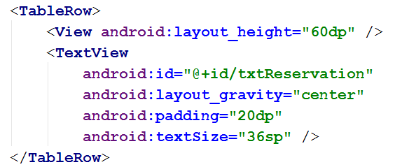
Code for Table Row 3 and Row 4
Row 3
Row 4

Slide 16
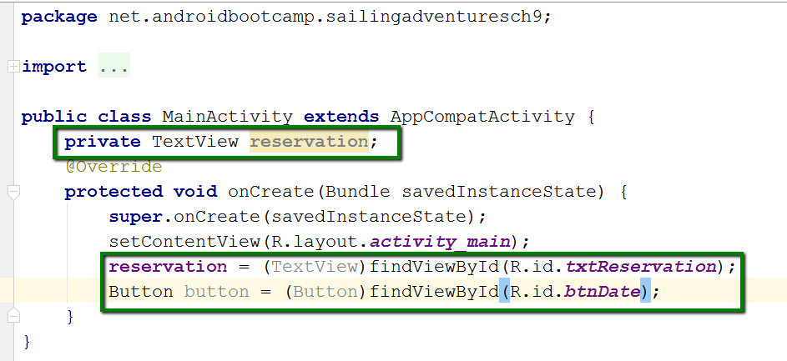
Update java code in MainActivity.java
Add code in all colored boxes as shown
The TextView object named reservation will be accessed in more than one method.
So it must be declared as a class variable – above all the methods

Slide 17
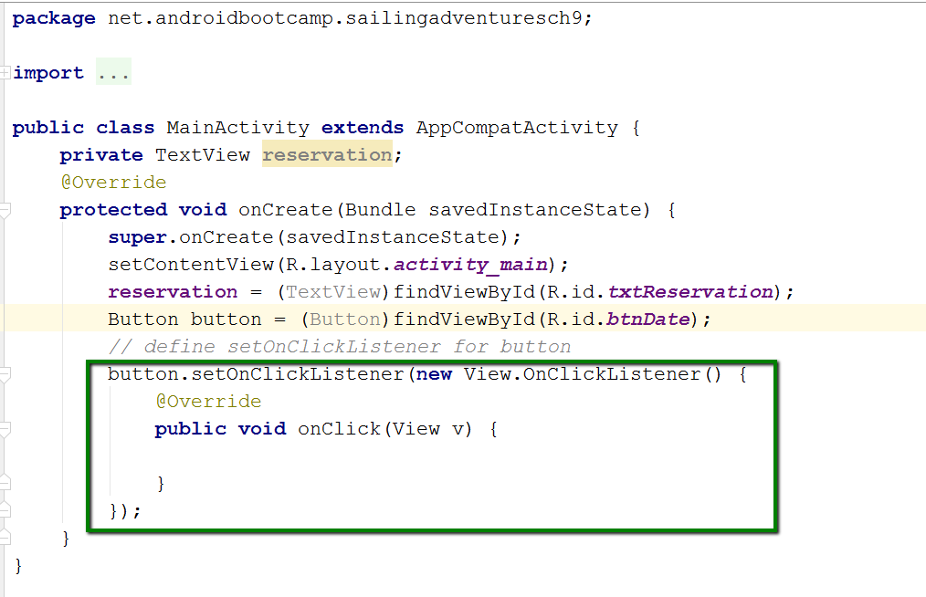
Define setOnClickListener and onClick
Type first line of code in box.
Most of the rest will be entered automatically.

Slide 18
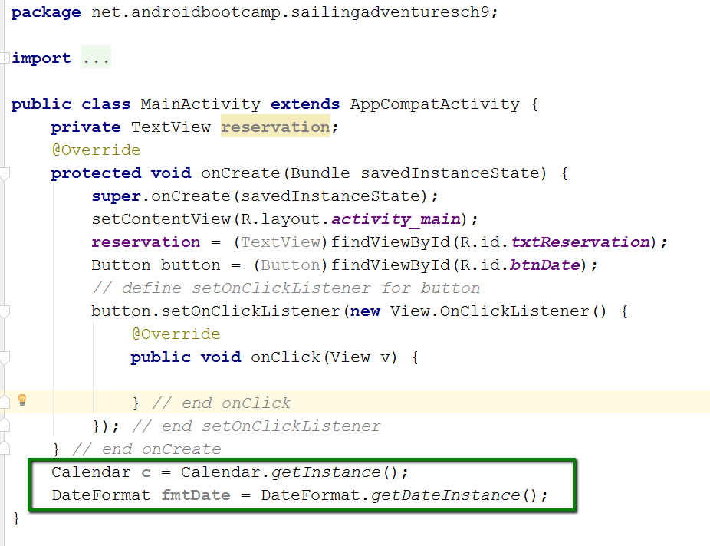
Add Calendar and DateFormat objects
Calendar class
Converts between an Date object and set of integer fields.
getInstance() – returns calendar date and time based on system settings
DateFormat class
Sets date to default long style for default country format

Slide 19
Add DatePickerDialog to onClick
DatePickerDialog:
Uses instance of Calendar class, c, to access system data.
Uses get() method to retrieve data
Uses set() method to set data
The d parameter will be created in next slide

Slide 20
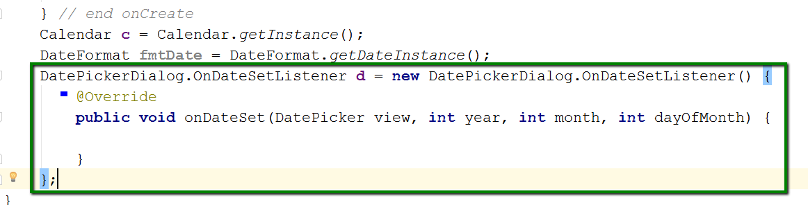
Define OnDateSetListener object
Defines d parameter from previous slide
Purpose is to listen for a callback that indicates user is done entering date.

Slide 21
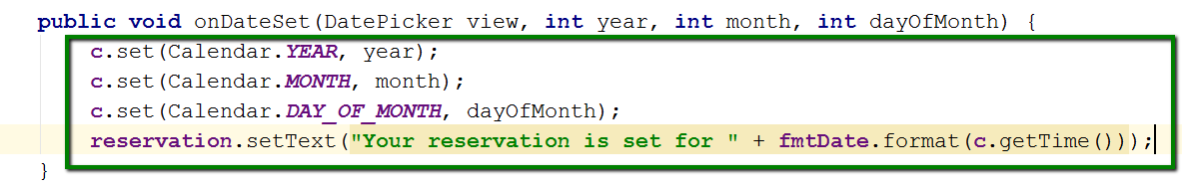
Add code to onDateSet Method
Use the object of the Calendar class, c, and the set method.
Use parameters from automatically created onDateSet method (year, month, dayOfMonth).
Use getTime() method within fmtDate object to display the time.
Only date will be displayed

Slide 22
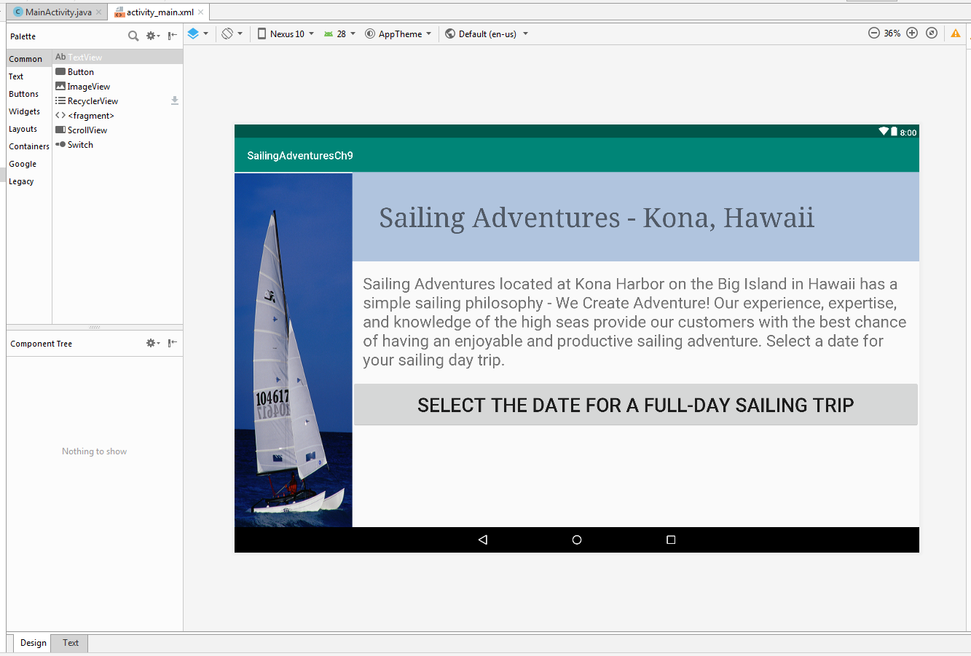
Before running, you should have this:

Slide 23
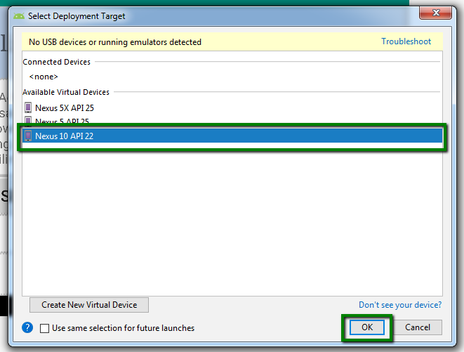
When running, select Nexus 10 API 22

Slide 24
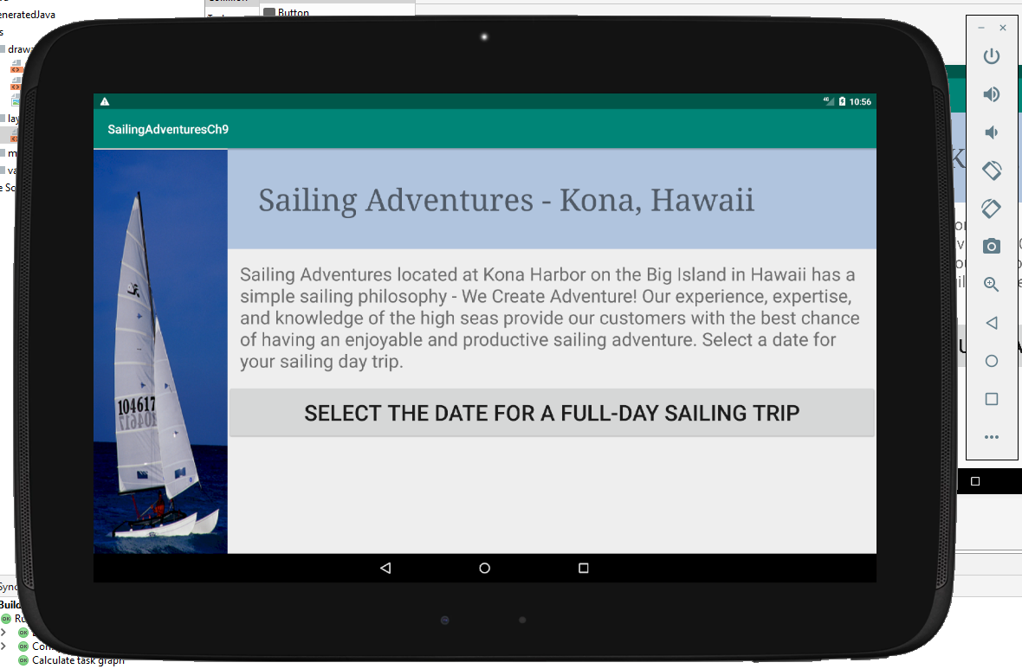
Run the app. You should get this:

Slide 25
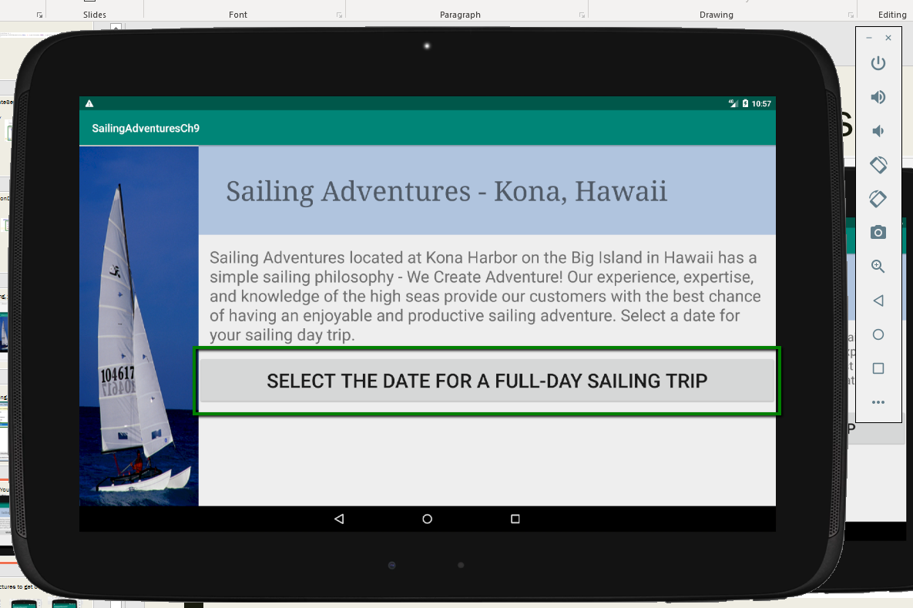
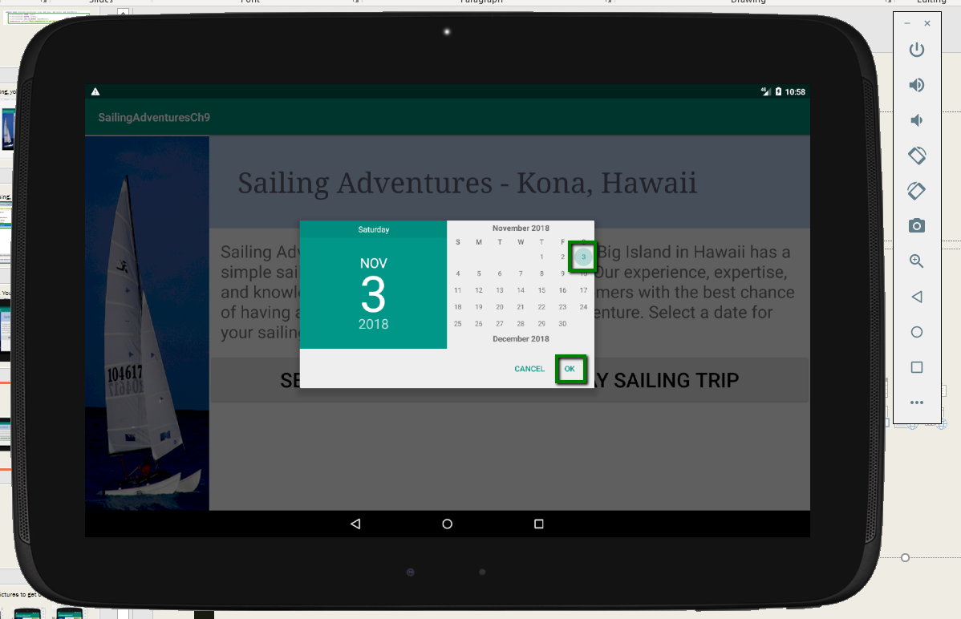
Click the button, select a date, click OK

Slide 26
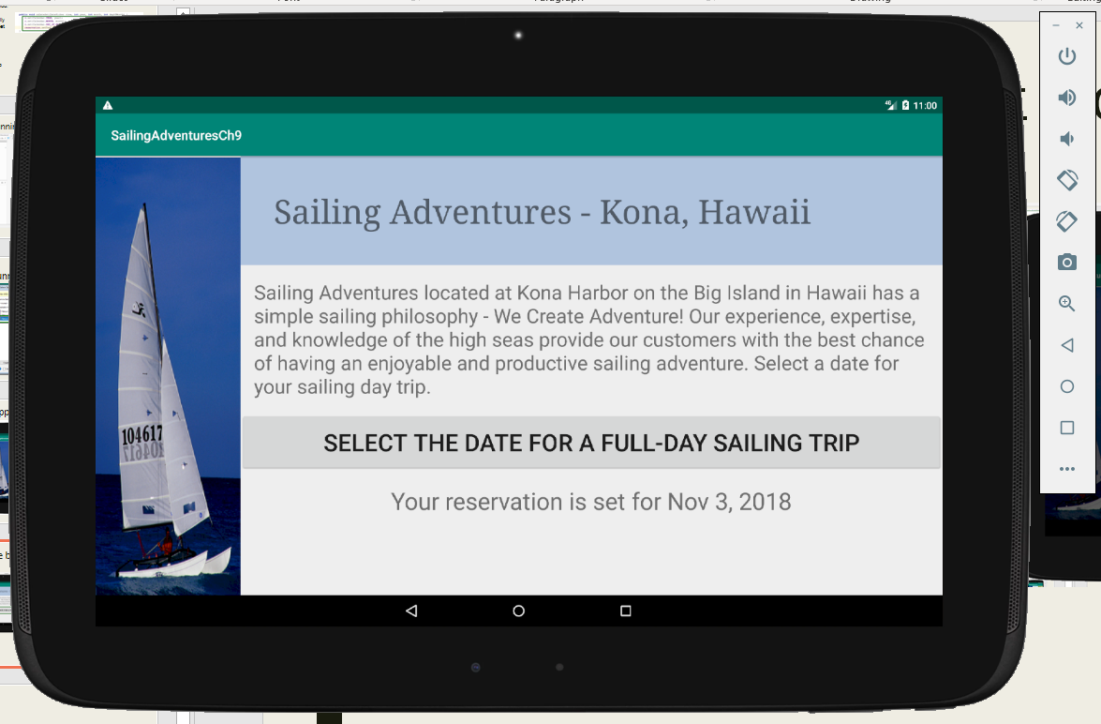
Final output displays just date, not time

